Slide 1
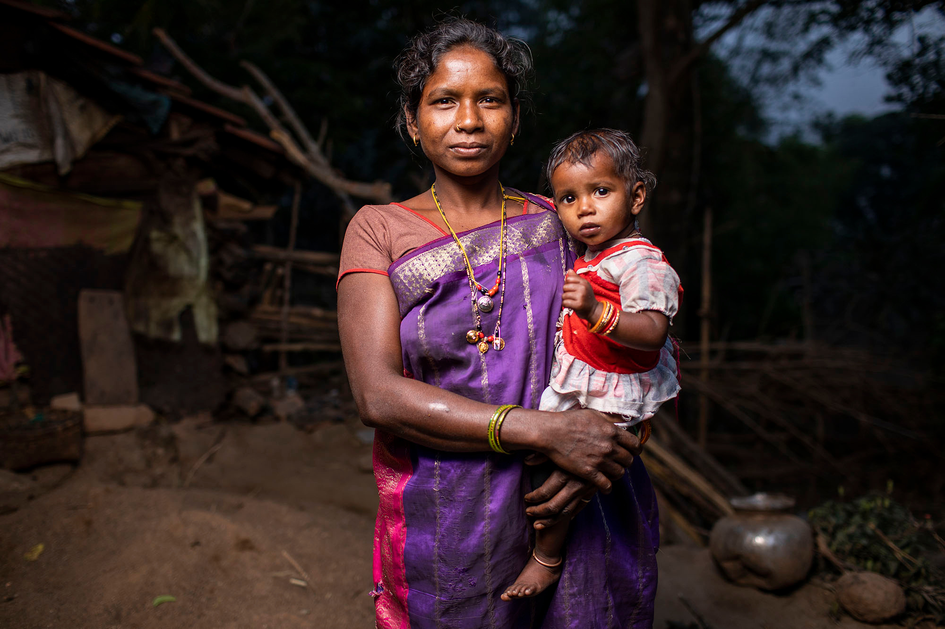

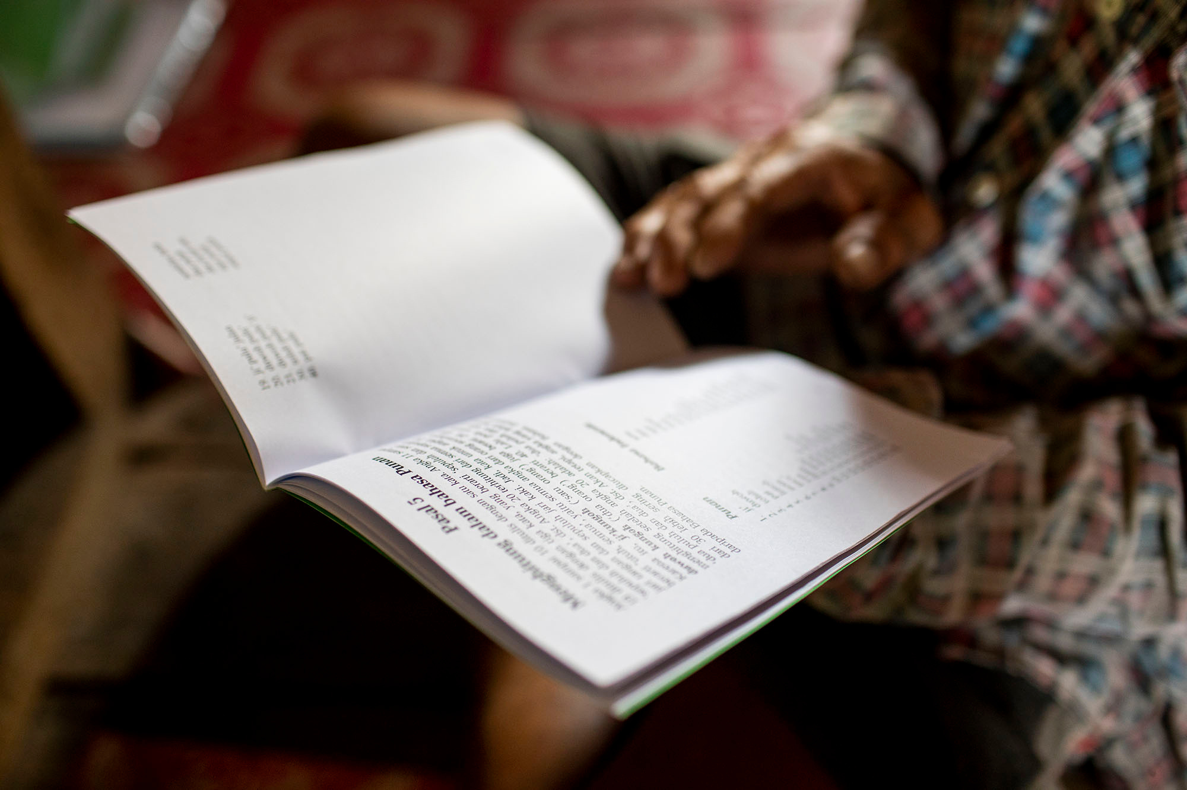
People without Scripture: 40,090,793
ProgressBible™. SNAPSHOT. (December 2025).
Notes:
Approximate number of people without a single verse of Scripture.
https://seedcompany.domo.com/page/1918325025/kpis/details/222008227
(Domo card is pulled from the Progress.Bible monthly snapshot.)

Slide 2
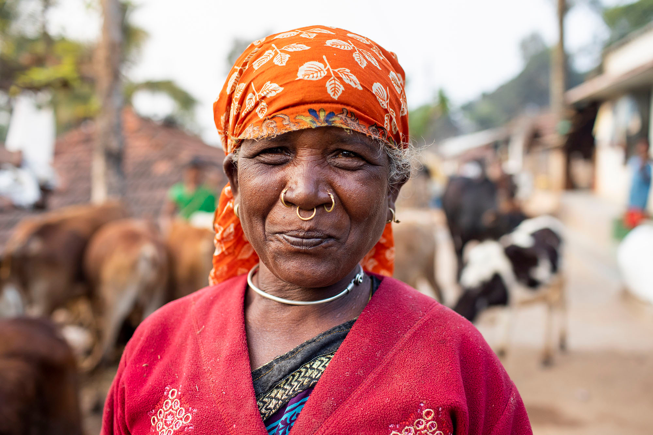

Global Bible Translation Realities for the World’s 7,391 Languages
1,813
784
languages with a New Testament
languages with a
complete Bible
541
languages with
no Scripture
ProgressBible™. SNAPSHOT. (December 2025).
Notes:
Source: Progress.Bible Monthly Snapshot (https://seedcompany.domo.com/page/1918325025)
Languages with no apparent need = "Translation Status by Continent: Languages" count for Low Language Vitality (languages that do not have sufficient vitality to support translation)
Languages with a complete Bible = "Completed Scripture by Continent: Languages" count for Bibles
Languages with some Scripture = "Completed Scripture by Continent: Languages" totals for selections, stories, and New Testaments
Languages with no Scripture = "Languages with No Scripture by Continent" total
These are presented here for a broad picture, but they are not intended to be added together. To reach the total number of languages, subtract the number of "languages with no apparent need" since that falls under the "languages with no Scripture."

Slide 3
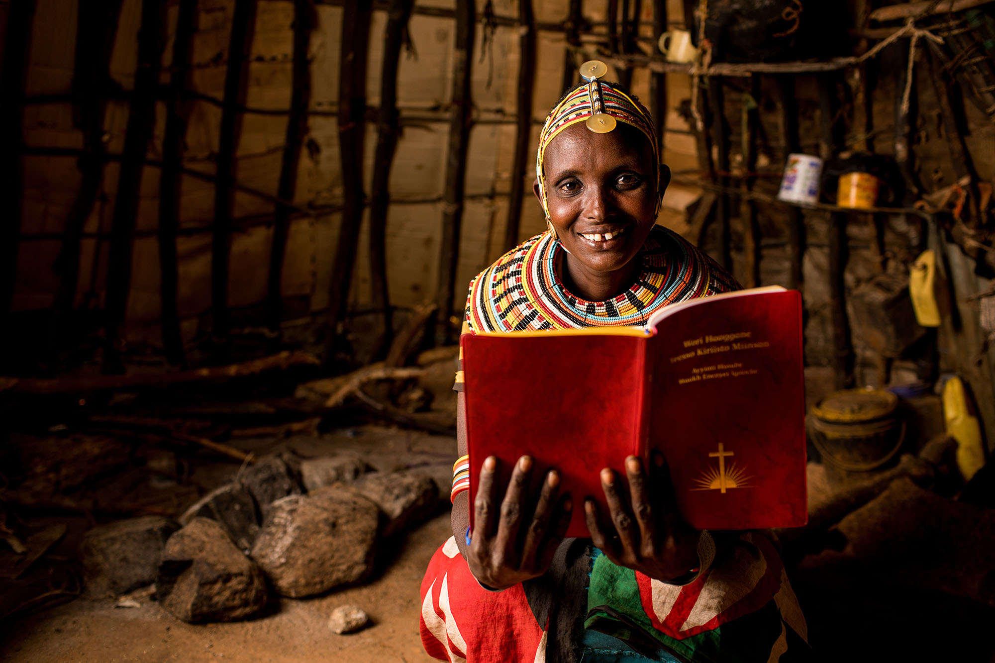
Mission
To accelerate Scripture translation and impact for people without God’s Word through Great Commission partnerships
Vision
God’s Word transforming lives in every language in this generation
Notes:
Highlight how these two statements drive every decision at Seed Company.
Highlight key words in mission statement and use these words as a theme throughout the presentation: accelerate, impact, Great Commission partnerships.

Slide 4
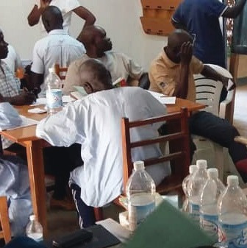
Didi Language
[DEE’–DEE]
Start Year: 2024
End Year: 2027
Population: 47,500
Location: Africa

Slide 5
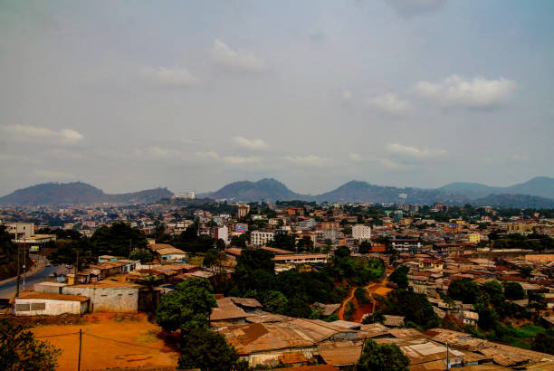
GOALS
  Finish translating Job through Isaiah and seven Minor Prophets and publish on an app.
  Publish Genesis, Numbers, Deuteronomy, and Ruth via print.
  Audio record Ruth, Jonah, and 500 other verses and distribute via SD cards.

Slide 6
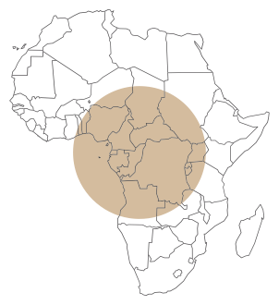
10,555
VERSES IN PROJECT
BOOK
VERSES IN
VERSES IN
BOOK
THIS PROJECT
Genesis Numbers Deuteronomy Ruth Job Psalms Proverbs Ecclesiastes Song of Solomon Isaiah Jonah Micah Nahum Habakkuk Zephaniah Haggai Zechariah Malachi
1,533 1,288 959 85 1,070 2,461 915 222 117 1,292 48 105 47 56 53 38 211 55
1,533 1,288 959 85 1,070 2,461 915 222 117 1,292 48 105 47 56 53 38 211 55

